Slide 1


CS251 – Software Engineering I
Lecture 1
Intro. Software Engineering
Mohammad El-Ramly, PhD
2015
http://www.acadox.com/join/75UDWT

Slide 2
دعاء
رب اشرح لى صدرى و يسر لى أمرى و احلل عقدة من لسانى يفقهوا قولى

Slide 3
Lecture 1 Outline
Course Objectives
Overview of Software Engineering
Course Administration
Course Assessment

Slide 4
I. Objectives₁
Teaching students the disciplined approach to engineering software systems.
Educating the students about the cost of software failures and the importance of software engineering.
Training the students on applying engineering practices in software development.
Introducing learners to the Software Engineering Body of Knowledge.

Slide 5
Objectives₂
Training them on the basics of software requirements engineering, modeling, and design, construction and configuration and process management.
Training the students on system modeling using UML.
Training students on teamwork.

Slide 6
Objectives₃
Coders - Can pretty much figure out it. It'll work, but it won't be pretty.
Hackers - usually low level folks, skillful, with detailed understanding of some area deeply, often scarily deeply.
Programmer - Write code and understand algorithms. Often work alone and well.
Software Engineer - Are the best generalists, can use lots of different systems and languages and get them to talk to each other. Are true and broad professionals, work with people, and communicate well.

Slide 7


Slide 8




An Hour of Code
Code.org
CodeCombat.com
TouchDevelop.com
وقفة أمريكية

Slide 9
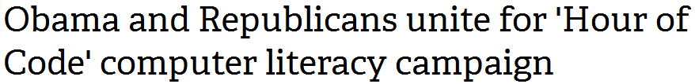
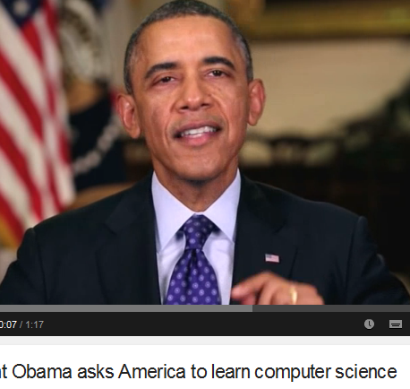


UK
US

Slide 10


Slide 11
High Demand for Qualified Software Engineers
Competition for software engineers continues to accelerate, with salaries being an area employers compete aggressively on to win talent.

Slide 12
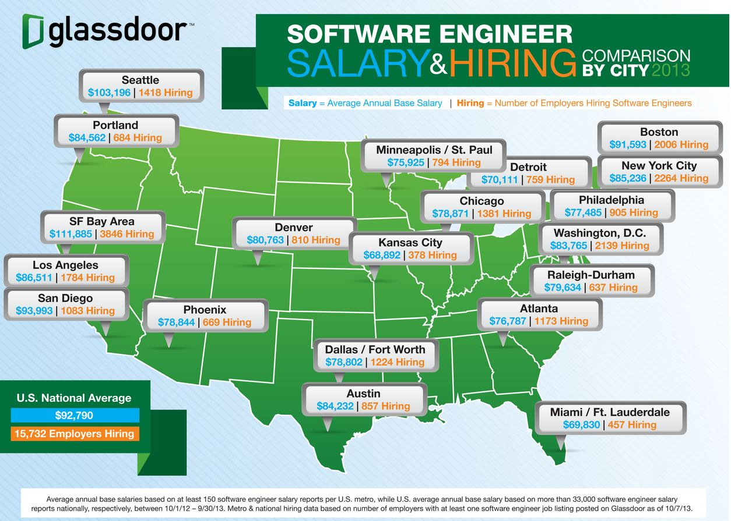

Slide 13
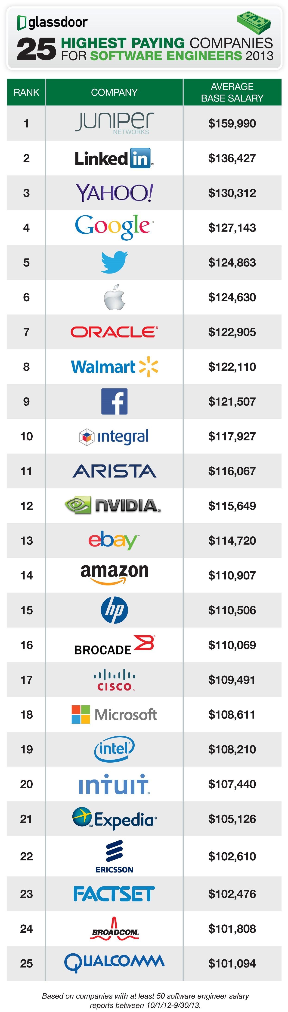

Slide 16
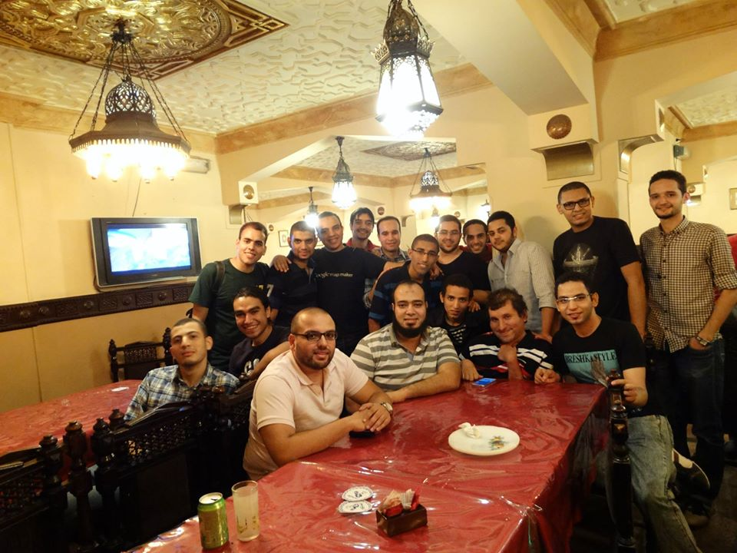

Slide 17
Amr Samir - Mohamed Gamal Hassan => Google
Badr El-Said - Marwan Naggar => Facebook
Ahmed Aly => HackRank
Yasser Yahia => Amazon
Omar - Mohammed Magdi - khaled => Prezi
Ahmed Saad - Hussien => Valeuo
Ahmed Abd hay => Instinct games
Mostafa Saad => Simon Fraser University

Slide 18
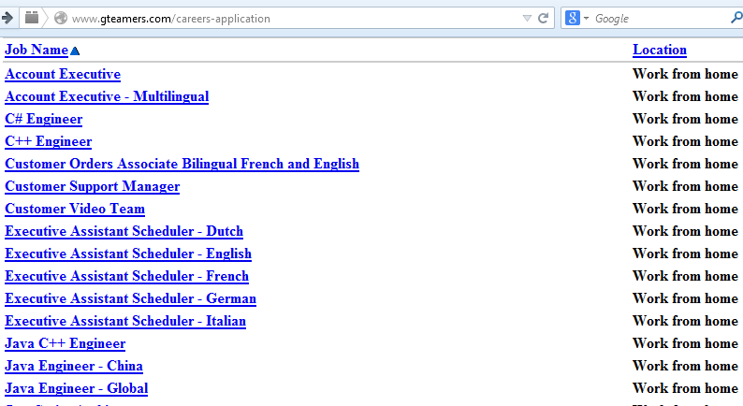
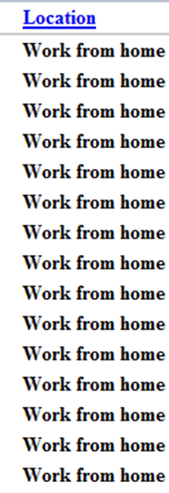
You can even work anywhere …

Slide 19
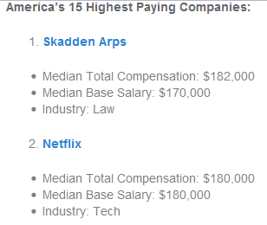
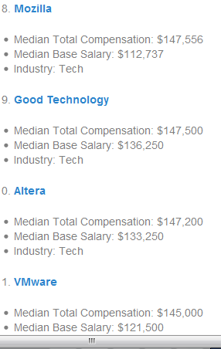
http://www.glassdoor.com/blog/americas-15-highest-paying-companies/

Slide 20
Job Description
gTeam is looking for a stellar Chief Architect to be responsible for the architecture, design and delivery of an Enterprise software product in its portfolio. As the owner for the architecture and technical delivery of a multi-million dollar revenue per year enterprise software product, you will effectively work as the CTO of the engagement with a startup mindset, wearing multiple hats from lead architect and developer on the most complex elements of the product to technical team leader to solution evangelist ensuring that the customers are blown away by the technical differentiation and quality of the product.
Total compensation is US$200,000/year (cash) for 40 hours a week - with opportunities for top performers to bill above 40 hours when needed.

Slide 21
Job Description
I am looking for a number of Android Developers (contract and permanent) of all levels to work on an exciting Greenfield project to build software for point of sale devices. This opportunity will allow, not only for Android development but will give exposure to UI/UX design, core Java development, big data (Heroku/AWS) and also API design.
Responsibilities
  Work with product owners to finalize specifications for applications
  Design and create apps for Android devices
  Design and create API functionality to support the Apps
  Build web based management capability
  Assist with the specification and capture of end user statistics
  Work with the back-end team to ensure your App correctly processes transactions

Slide 22

Jason Gorman(SE Recuirter)
I help clients to recruit software developers, and I know that for every role that involves programming, you may get hundreds of applicants.
Of those hundreds of applicants, perhaps a dozen will be worth interviewing. Of those dozen, perhaps just one or two will actually be what enlightened employers consider to be good enough to let loose on their critical business systems and software products.
While there may not be a shortage of programmers, there's most definitely a chronic shortage of good software developers. That's something that didn't seem to cross anyone's mind - that there's much more to it than just programming, for a start, and that it takes years to develop the skills and knowledge needed to build good, valuable, reliable, maintanable, secure, scalable software.
http://codemanship.co.uk/parlezuml/blog/?postid=1208

Slide 23
Money is not everything …
لن تأخذ لقبرك شهادة و لا وظيفة و لا مال
و ابتغ فيما آتاك الله الدار الآخرة و لا تنس نصيبك من الدنيا
إنما الأعمال بالنيات و إنما لكل امرئ ما نوى
إن كان خرجَ يسعى على وَلَدِه صِغارًا ، فهو في سبيل الله ، وإن كان خرج يسعى على أبوين شيخين كبيرين ، فهو في سبيل الله، وإن كان خرج يسعى على نفسه ، يَعُفُّها، فهو في سبيل الله، وإن كان خرج يسعى رياء ومُفاخرة، فهو في سبيل الشيطان

Slide 25
II. What is this course about?
This is the third in a series of courses on software development.
  Programming 1 (CS112)
  Programming 2 (CS213)
  Algorithms and Data Structures (CS214)
    File Organization (CS215)
    Databases Systems 1 (IS211)
  Software Engineering 1 (CS251)
  Software Engineering 2 (CS352) – (CS, IS)

Slide 26
What Is Software?
More than computer programs.
The collection of programs, documentation and configuration data that ensures correct execution.

Slide 27
What Is Engineering?
Engineering is the discipline of applying technical and scientific knowledge and physical resources to design and produce materials, structures, machines, devices, systems, and processes that meet a desired objective under specified criteria.

Slide 28
What Is Software Engineering?
The process of solving customers’ problems by the systematic development and evolution of large, high-quality software systems within cost, time, and other constraints

Slide 29
When Did Software Engineering Start?
A term used occasionally in 1950s, 1960s
Popularized in 1968 at NATO Software Engineering Conference
http://homepages.cs.ncl.ac.uk/brian.randell/NATO/

Slide 30
What Is Software Engineering?
IEEE Standard 610.12:
  The application of a systematic, disciplined, quantifiable approach to the development, operation, and maintenance of software, that is, the application of engineering to software.
“Designing, building and maintaining large software systems”. - I. Sommerville
“Multi-person construction of multi-version software”. - D. L. Parnas

Slide 31
What Is Software Engineering?
IEEE Standard 610.12:
  The application of a systematic, disciplined, quantifiable approach to the development, operation, and maintenance of software, that is, the application of engineering to software.
“Designing, building and maintaining large software systems”. - I. Sommerville
“Multi-person construction of multi-version software”. - D. L. Parnas

Slide 32

The Goal of Software Engineering Is Producing Quality Software
Can be quite different based on your viewpoint:
Customer:
- Solves problems at acceptable cost (time and resource).
User:
- Easy to learn
- Efficient to use
- Get work done
Developer:
- Easy to design and maintain
- Successfully used and deployed
Developer Manager:
- Sells more and pleases customers
- Costing less to develop and maintain

Slide 33




Key Stages of Producing SW
Requirement
Analysis
Design
Implement
Test

Slide 35
SWEBOK’s Key 15 Knowledge Areas
REQ | Software Requirements
DES | Software Design
CST | Software Construction
TST | Software Testing
MNT | Software Maintenance
CNF | Software Configuration Management
MGT | Software Engineering Management
PRC | Software Engineering Process
TLS | Software Engineering Tools and Methods
QLY | Software Quality
SWEBOK 2004
Had 10 KAs
SWEBOK 2013
added 5 more KAs

Slide 36
SWEBOK’s Key 15 Knowledge Areas
SWEBOK 2013
added 5 more KAs
 | Software engineering professional practice
 | Software engineering economics
 | Computing foundations
 | Mathematical foundations
 | Engineering foundations
http://www.sebokwiki.org/wiki/An_Overview_of_the_SWEBOK_Guide

Slide 37
KA1. Software Requirements
The Software Requirements Knowledge Area (KA) is concerned with the elicitation, analysis, specification, and validation of software requirements.
It is widely acknowledged within the software industry that software engineering projects are critically vulnerable when these activities are performed poorly.
Software requirements express the needs and constraints placed on a software product that contribute to the solution of some real-world problem.

Slide 38
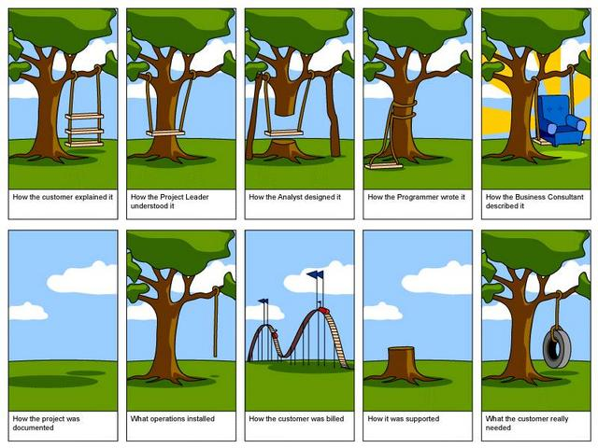
Software Requirements

Slide 39
KA2. Software Design
Design is defined as both “the process of defining the architecture, components, interfaces, and other characteristics of a system or component” and “the result of [that] process.” Viewed as a process, software
Software design is the activity in which software requirements are analyzed in order to produce a description of the software’s internal structure that will serve as the basis for its construction.

Slide 40
KA3. Software Construction
The term software construction refers to the detailed creation of working, meaningful software through a combination of coding, verification, unit testing, integration testing, and debugging.

Slide 41
K4. Software Testing
Testing is performed to evaluate and improve product quality by identifying defects and problems.
Software testing consists of the dynamic verification of a program’s behavior on a finite set of test cases, suitably selected from the usually infinite executions, against the expected behavior.

Slide 42
KA5. Software Maintenance
Software development efforts result in the delivery of a software product that satisfies user requirements. Accordingly, the software product must change or evolve.
Once in operation, defects are uncovered, operating environments change, and new user requirements surface.
  The maintenance phase of the life cycle begins following a warranty period or post-implementation support delivery, but maintenance activities occur much earlier.

Slide 43
KA6. Software Configuration Management
Software configuration management (SCM) is the task of tracking and controlling changes in the software, part of the larger cross-discipline field of configuration management.”
SCM practices include revision control and the establishment of baselines. If something goes wrong, SCM can determine what was changed and who changed it.

Slide 44
KA7. Software Engineering Management
Software Engineering Management can be defined as the application of management activities — planning, coordinating, measuring, monitoring, controlling, and reporting—to ensure that the development and maintenance of software is systematic, disciplined, and quantified.

Slide 45
KA8. Software Engineering Process
In this knowledge area “software engineering processes” are concerned with work activities accomplished by software engineers to develop, maintain, and operate software, such as software requirements, software design, software construction, software testing, software configuration management, and other software engineering processes.

Slide 46
KA10. Software Quality
Software quality assurance (SQA) consists of a means of monitoring the software engineering processes and methods used to ensure quality. The methods by which this is accomplished are many and varied, and may include ensuring conformance to one or more standards, such as ISO 9000 or a model such as CMMI.

Slide 48
III. Course Contents₁
Introduction and Overview of SE ½ week
Review of OOP Principles ½ week
Software Crisis ½ week
Requirements Engineering 2 weeks
  Software Requirements Specifications
  Techniques for Collecting Requirements
  Use Case Models
Software Change and Configuration Management
½ week
Software Engineering Ethics ½ week

Slide 49
III. Course Contents₂
Modeling and Design with UML 4 weeks
  Capturing System Structure with Class Diagram
  Capturing System Interactions with Sequence Diagram
  Capturing State Transitions with State Charts
  UML Modeling Using Tools
  Transforming Models into Code
Software Engineering Process Models 1 week
Introduction to Design Patterns and Model-View-Controller 1 week

Slide 50
Course Etiquette
You must attend all lectures, sections and labs on time.
You must actively participate in discussions, assignments, group work, etc.
Code of honor
  No copying from any source
  Submit only your own original work
You are encouraged to ask questions.
You are encouraged to offer answers.

Slide 51
Course Tools
This course will introduce a combination of new tools for software Engineering:
  A Java IDE environment like Eclipse, NetBeans or Jcreator
  A UML modeling tool like ArgoUML, Visual-Paradigm or Rational Rose
  A configuration management tool / platform like GitHub or BitBucket

Slide 52
For next time …..
Join http://www.acadox.com/join/75UDWT
Review lecture 1 content (slides and notes)
Watch lecture 2 video
  6 parts, link in acadox is to part 1/6 only !!
Do lab 1
Study for Quiz 1
Start working on A1
Bring a notebook and blue and red pens.

Slide 53
Readings
Readings are essential for this course. You must read them thoroughly when requested to do so.
Recommended textbook:
  Object Oriented Software Engineering: Practical software development using UML and Java, 2nd Ed., by Timothy Lethbridge
Important recommended readings will be added as the course progresses.

Slide 55
IV. Course Assessment
Final exam 60 marks
In/off class quizzes 10 marks
Midterm exam 5 marks
Lab and section exercises 5 marks
Assignments 20 marks
    A1 is out today
    A2-A4 are course project
Participation portfolio 3 marks bonus
  Notebook and answers of in lecture practices

Slide 57
Next Lecture (Video)
Basics of OOP (What defines OO paradigm)
  Identity
  Classification
  Abstraction
  Encapsulation
  Aggregation
  Inheritance
  Polymorphism
  Genercity
Steps of OOP Development Methodology

Slide 58
كيف تنجح فى هذا الكورس
جدد النية و استعن بالله و لا تعجز
نظم وقتك و خصص وقت و مكان مناسبين للدراسة وفق جدول ثابت يناسب ظروفك
شاهد فيديوهات المحاضرات و ذاكر للمحاضرة قبل أن تأتى
شارك فى تمارين المحاضرة و استفد من زملائك
اعمل تمارين المعمل سواءا فى الكلية أو البيت
شارك بقوة فى مشروع المقرر
كن مستعدا للتغيير و تبني عقلية النجاح.
  التغيير يحتاج لممارسة العادة الجديدة 30 يوماً

Slide 59




Pearls of Wisdom
Early sleep
And early rise
Work like hell
And advertise

Slide 60
(وَالْفَجْرِ.. جنتي)
إذن.. القاعدة هنا أن بوابة الجنة هي صلاة الفجر، والفجر (فَادْخُلِي فِي عِبَادِي (29) وَادْخُلِي جَنَّتِي) صلاة الفجر ليس فرديًا، وإنما جماعيًا، (فَادْخُلِي فِي عِبَادِي (29) وَادْخُلِي جَنَّتِي)
قال رسول الله ص: بورك لأمتى فى بكورها
قالت السيدة عائشة: عجبت لمن يصلى الفجر بعد شروق الشمس كيف يرزق؟

